Slide 1
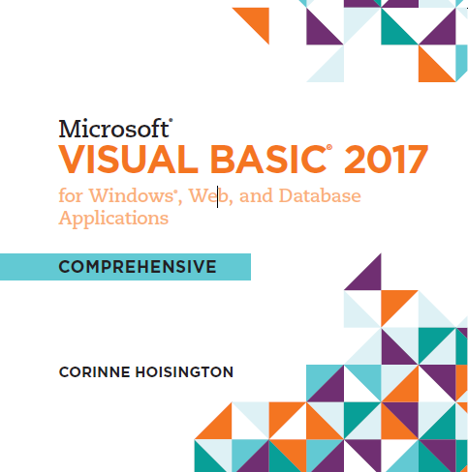

Microsoft Visual Basic 2017 for Windows®, Web, and Database Applications
Chapter 2 Program and Graphical User Interface Design
Copyright © 2016 Cengage Learning®. May not be scanned, copied or duplicated, or posted to a publicly accessible website, in whole or in part.

Slide 2
Objectives (1 of 2)
Create a Visual Basic 2017 Windows Desktop Application project
Name and set the Title Bar text in a Windows Form object and resize a Windows Form object
Add a Label object to a Windows Form object, name the Label object, set the text in the Label object, and change the Font properties of the text in the Label object
Add a PictureBox object to the Windows Form object, name the PictureBox object, and resize the PictureBox object

Slide 3
Objectives (2 of 2)
Add a Button object to the Windows Form object, name the Button object, set the text in the Button object, and change the Button object’s size
Align objects on the Windows Form object
Save, close, and open Visual Basic projects
Understand and implement design principles of the graphical user interface
Understand and implement the first two phases of the program development life cycle

Slide 4
Introduction (1 of 5)
Before a program can be coded using Visual Basic 2017, it must be designed.
Design and implement the application to illustrate the process of creating a computer program as an integrated development environment using Visual Basic 2017.
The application could be a part of a larger menu application use to select a coffee latte order at your favorite coffee shop
The program begins by displaying the Latte Selection window

Slide 5
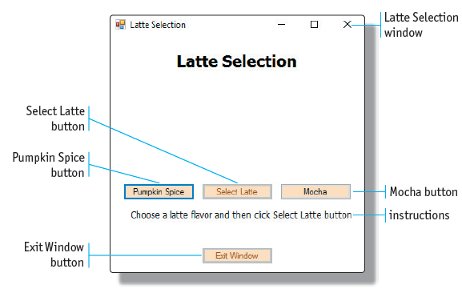
Introduction (2 of 5)

Slide 6
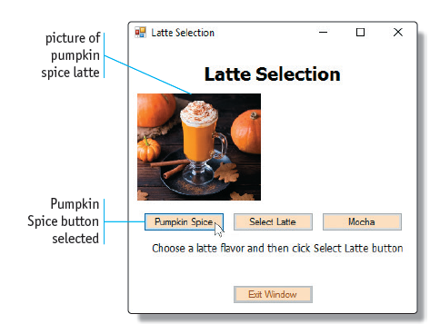
Introduction (3 of 5)
If the user clicks the Pumpkin Spice button, a picture of a pumpkin spice latte is displayed

Slide 7
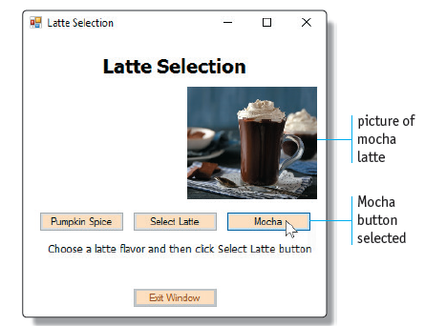
Introduction (4 of 5)
If the user clicks the Mocha button, a picture of a mocha latte is displayed

Slide 8
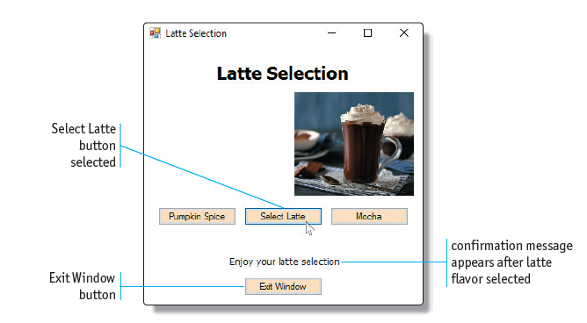
Introduction (5 of 5)
After choosing a latte flavor, the user can click the Select Latte button and the program informs the user that a flavored latte has been selected

Slide 9
Using Visual Studio 2017
When designing an event-driven program that uses a graphical user interface (GUI), such as the program in this chapter, one of the first steps after defining the purpose for the program is to design the user interface itself
Before beginning to design the user interface, however, the developer should know how to use Visual Studio and Visual Basic rapid application development (RAD) tools in the design process

Slide 10
Create a New Visual Basic 2017 Windows Desktop Project (1 of 4)
A project is equivalent to a single program created using Visual Studio
A Windows Classic Desktop project is a program that includes a user interface whose windows are created using the Windows operating system
When the program is executed, the user interacts with the program by using its windows and components (the user interface)

Slide 11
Create a New Visual Basic 2017 Windows Desktop Project (2 of 4)
Tap or click the New Project button on the Standard toolbar
If necessary, tap or click Windows Desktop in the left pane so that it is selected
If necessary, tap or click Windows Forms Application in the middle pane
Type the project name
Tap or click the OK button in the New Project window

Slide 12
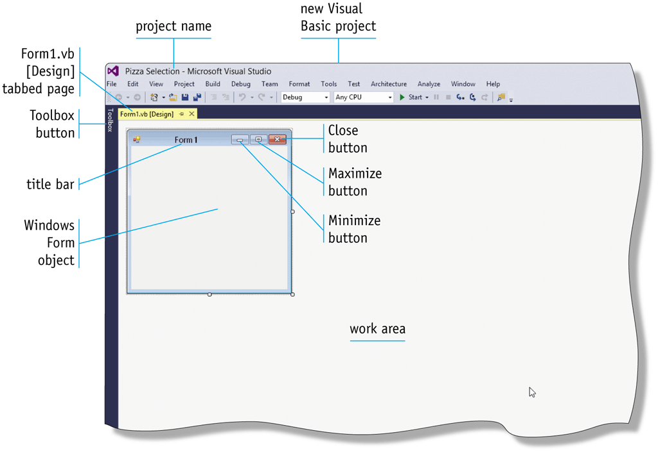
Create a New Visual Basic 2017 Windows Desktop Project (3 of 4)

Slide 13
Create a New Visual Basic 2017 Windows Desktop Project (4 of 4)
The Visual Studio window contains several important features you should know. First, in the portion of the window known as the work area, a tabbed page named Form1.vb [Design] contains a Windows Form object called Form1
A Windows Form object is the window you will use to build the program and then display it on your screen when you execute the program

Slide 14
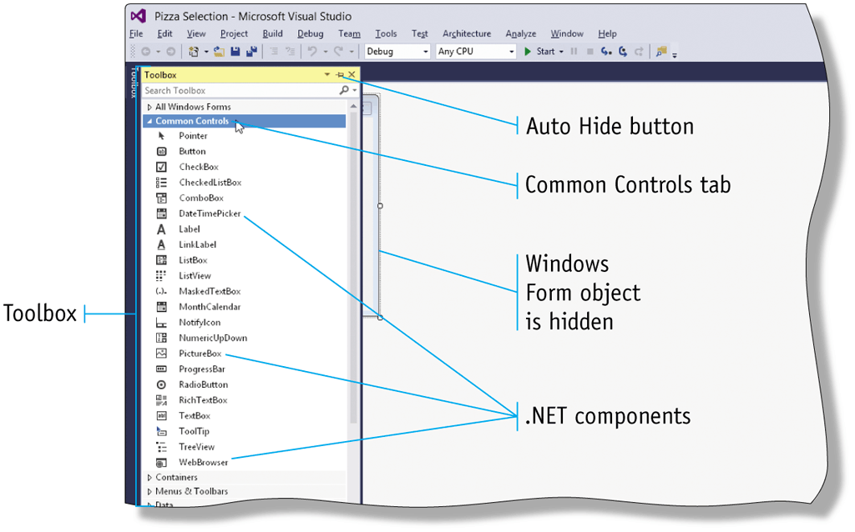
Display the Toolbox
If the window does not already display the Toolbox, tap or click the Toolbox button in the left margin of the window. If necessary, tap or click Common Controls to display the Common Controls tab

Slide 15
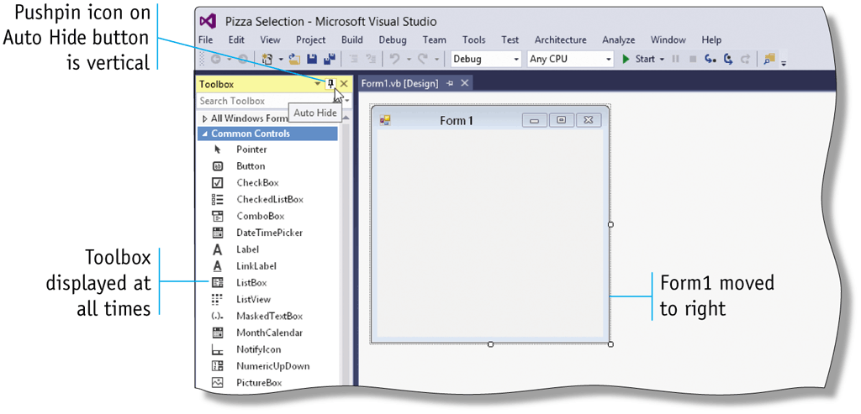
Permanently Display the Toolbox
If necessary, tap or click the Toolbox button in the left margin of the window to display the Toolbox. Then, tap or click the Auto Hide button (Pushpin icon) on the Toolbox title bar

Slide 16
View Object Properties (1 of 2)
Properties can describe a multitude of characteristics about the object, including its color, size, name, and position on the screen
In the Properties window, the property names in the left list appear in Alphabetical view
Many developers find the Alphabetical view the easiest to use when searching for properties

Slide 17
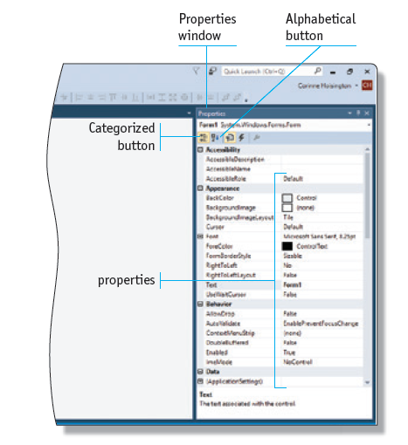
View Object Properties (2 of 2)

Slide 18
Name the Windows Form Object (1 of 2)
Tap or click anywhere in the Windows Form object to select it and then tap or click View on the menu bar
If necessary, tap or click Solution Explorer on the View menu to display the Solution Explorer. In the Solution Explorer window, press and hold or right-click the Form1.vb file name to display a shortcut menu with the Rename command
Tap or click Rename. Type frmLatteSelection.vb and press the ENTER key

Slide 19
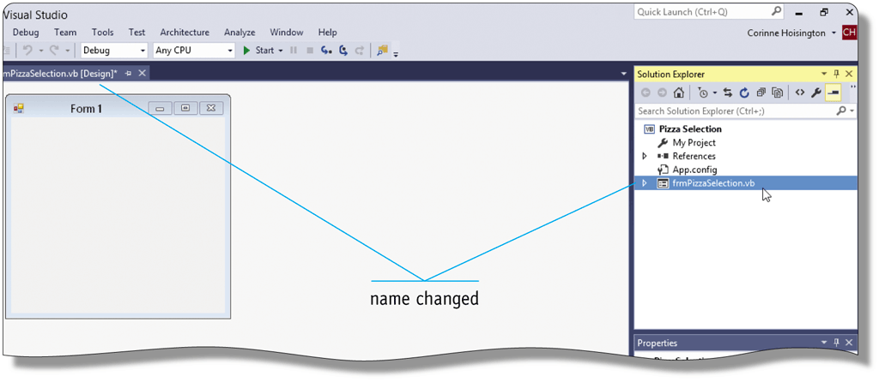
Name the Windows Form Object (2 of 2)

Slide 20
Set the Title Bar Text in a Windows Form Object (1 of 2)
The Text property in the Properties window for the Windows Form object contains the value displayed in the title bar of the window
Click the Windows Form object and then scroll in the Properties window as necessary until you find the Text property. Then, double-tap or double-click the Text property in the right column
Type Latte Selection and then press the ENTER key

Slide 21
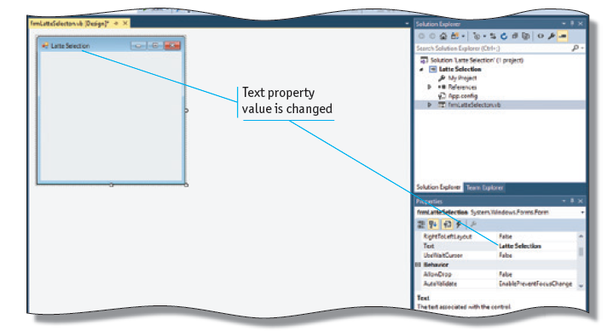
Set the Title Bar Text in a Windows Form Object (2 of 2)

Slide 22
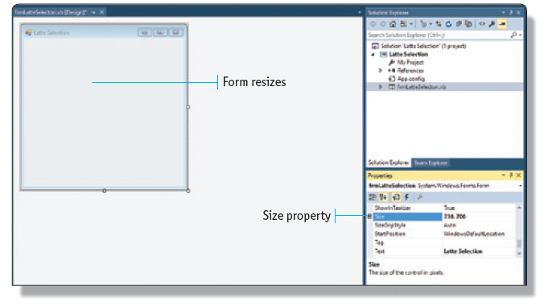
Resize a Form
With the Windows Form object selected, double-click the Size property in the right column. Type 730, 700 and then press the ENTER key

Slide 23
Add a Label Object (1 of 2)
Drag the Label .NET component from the Common Controls tab in the Toolbox over the Windows Form object to the approximate location where you want to place the Label object
When the Label object is in the correct location, release the left mouse button

Slide 24
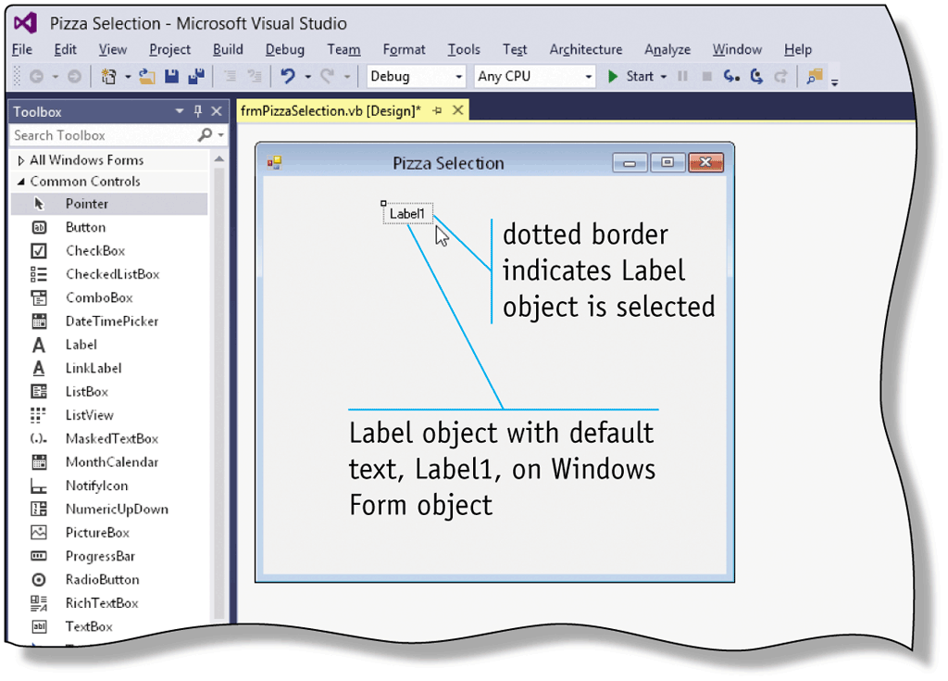
Add a Label Object (2 of 2)

Slide 25
Name the Label Object (1 of 2)
With the Label object selected, scroll in the Properties window until you find the (Name) property. Then, double-tap or double-click the (Name) property in the right column
Type the new name, and then press the ENTER key

Slide 26
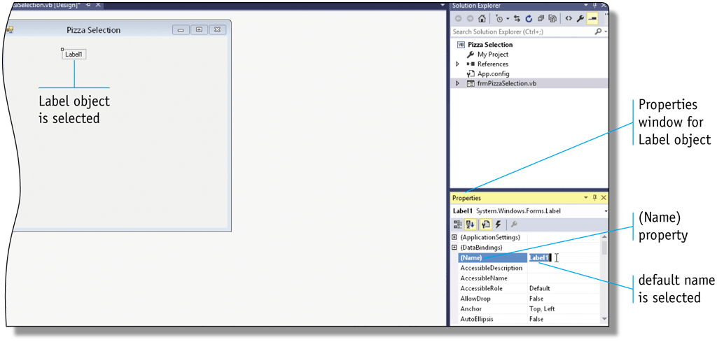
Name the Label Object (2 of 2)

Slide 27
Change the Text in a Label Object (1 of 2)
With the Label object selected, scroll in the Properties window until you find the Text property. Then, double-tap or double-click the Text property in the right column
Type the new text for the Text property and press the ENTER key

Slide 28
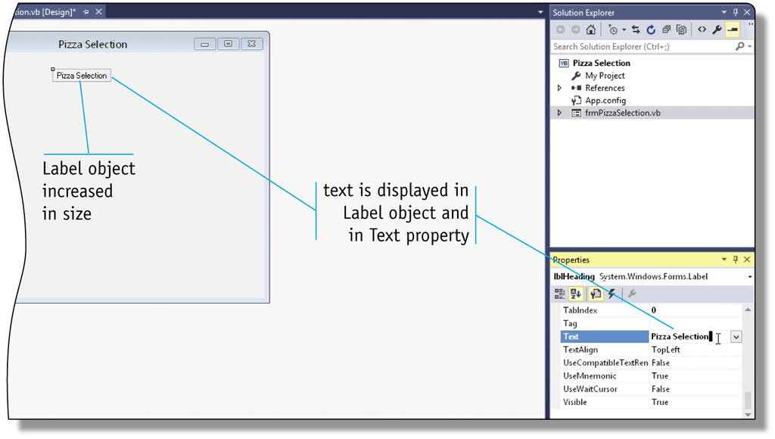
Change the Text in a Label Object (2 of 2)

Slide 29
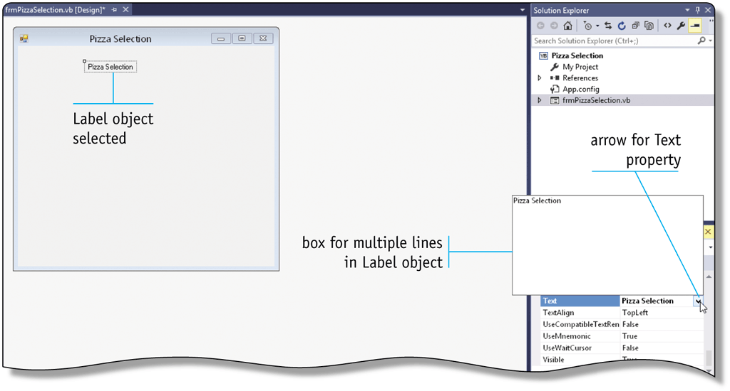
Enter Multiple Lines of Text in a Label Object
With the Label object selected, tap or click the Text property name in the left column of the Properties window. Then, tap or click the arrow in the right column of the Text property

Slide 30
Change the Label Font, Font Style, and Font Size (1 of 2)
Tap or click the Label object to select it. Scroll until you find the Font property in the Properties window. Tap or click the Font property in the left column of the Properties window. Tap or click the ellipsis button for the Font property
In the Font dialog box, scroll in the Font list to the font you want to use and then tap or click it. Tap or click a desired font style in the Font style list. Tap or click the size you want to use in the Size list
Tap or click the OK button

Slide 31
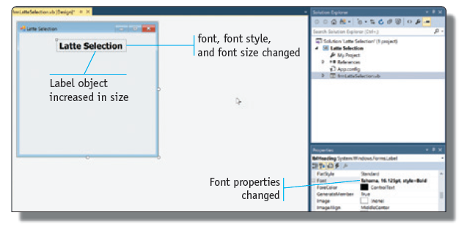
Change the Label Font, Font Style, and Font Size (2 of 2)

Slide 32
Center a Label Object in the Windows Form Object (1 of 2)
With the Label object selected, tap or click Format on the menu bar and then point to Center in Form on the Format menu
Tap or click Horizontally on the Center in Form submenu

Slide 33
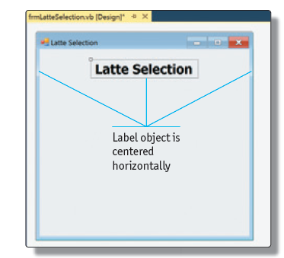
Center a Label Object in the Windows Form Object (2 of 2)

Slide 34
Delete GUI Objects
Select the object from the Windows Form Object to delete by tapping or clicking it
Press the DELETE key

Slide 35
Use the Undo Button on the Standard Toolbar
Tap or click the Undo button on the Standard toolbar

Slide 36
Add a PictureBox Object (1 of 2)
A PictureBox is an object much like a label
With the Toolbox visible, drag the PictureBox .NET component on the Toolbox over the Windows Form object to the approximate location where you want the PictureBox object to be displayed
When the pointer is in the correct location, release the left mouse button

Slide 37
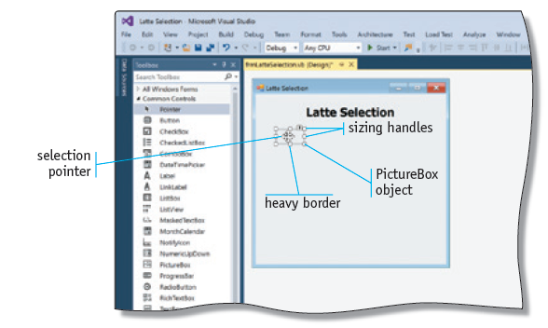
Add a PictureBox Object (2 of 2)

Slide 38
Name a PictureBox Object
Select the PictureBox object
Locate the (Name) property in the Properties window for the PictureBox object
Double-tap or double-click the value in the right column for the (Name) property, type the name, and then press the ENTER key

Slide 39
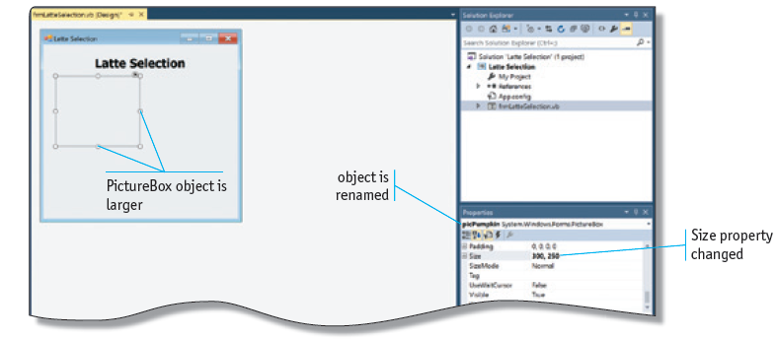
Resize a PictureBox Object
Double-tap or double-click to the right of the Size property of the PictureBox object, type the desired size, and then press the ENTER key

Slide 40
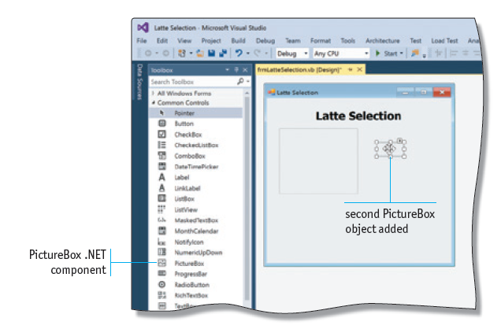
Add a Second PictureBox Object
Drag the PictureBox .NET component in the Toolbox to any location in the Windows Form object, and then release the left mouse button

Slide 41
Make Objects the Same Size (1 of 2)
Select the object whose size you want to duplicate, hold down the CTRL key, and tap or click the object you want to resize
Tap or click Format on the menu bar and then point to the Make Same Size command on the Format menu
Tap or click Both on the Make Same Size submenu

Slide 42
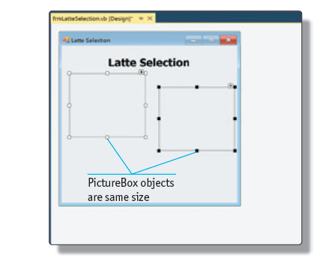
Make Objects the Same Size (2 of 2)

Slide 43
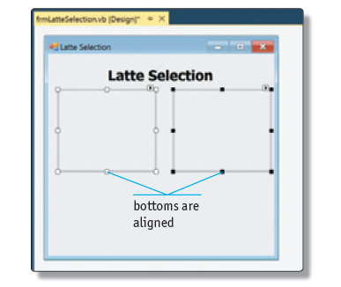
Align the PictureBox Objects
With the left and the right PictureBox objects selected, tap or click Format on the menu bar and then point to Align on the Format menu
Tap or click Bottoms on the Align submenu

Slide 44
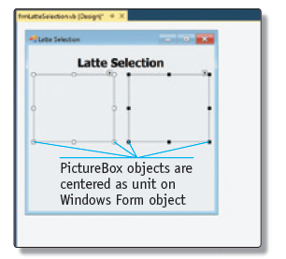
Center Multiple Objects Horizontally in the Window
With both PictureBox objects selected, tap or click Format on the menu bar and then point to the Center in Form command
Tap or click Horizontally on the Center in Form submenu

Slide 45
Add a Button Object (1 of 2)
With the Toolbox displayed in the Visual Studio window, drag the Button control in the Toolbox over the Windows Form object to the position where you want to place the button
When the pointer is positioned properly, release the left mouse button

Slide 46
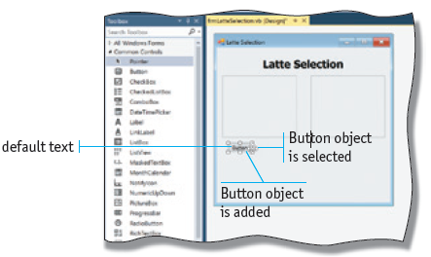
Add a Button Object (2 of 2)

Slide 47
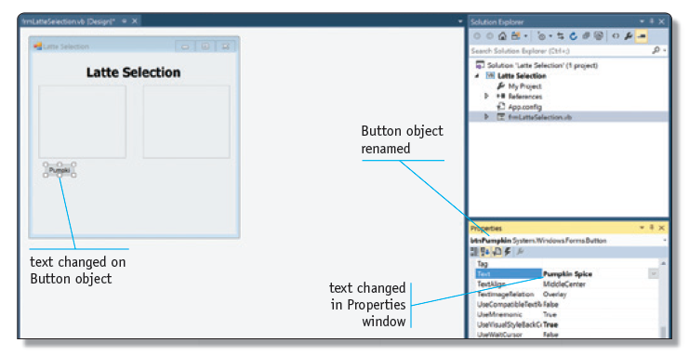
Name and Set Text for a Button Object
With the Button object selected, scroll in the Properties window until you find the Text property. Double-tap or double-click the Text value in the right column, type the text you want to display, and then press the ENTER key

Slide 48
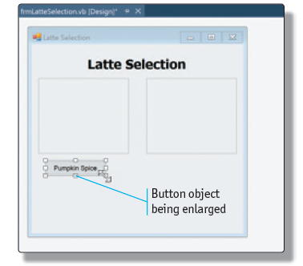
Change a Button Object’s Size
Place the pointer over the right edge of the Button object until the pointer changes to a double-headed arrow
Drag the pointer to the right to increase the button’s width, and then release the left mouse button

Slide 49
Add and Align a Second Button (1 of 2)
Drag the Button .NET component from the Toolbox to the desired location on the Windows Form object. Align the top of the rectangle in the pointer to the top of the other button until a red line appears under the text of the buttons
When the buttons are aligned and spaced as you like, release the left mouse button

Slide 50
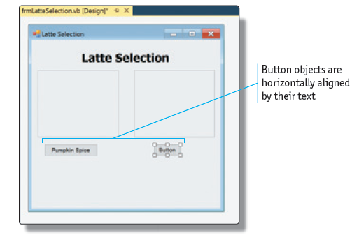
Add and Align a Second Button (2 of 2)

Slide 51
Aligning Objects Vertically (1 of 2)
If necessary, click anywhere in the Windows Form object to deselect any other objects. Then, slowly drag the Mocha button below the Pumpkin Spice button until vertical blue snap lines are displayed.
When the blue lines appear, indicating the buttons are aligned vertically, drag the Mocha button up or down to create the proper spacing between the buttons, and then release the left mouse button.

Slide 52
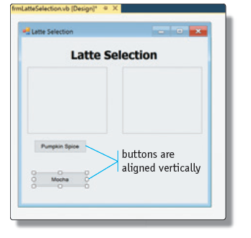
Aligning Objects Vertically (2 of 2)

Slide 53
Saving, Closing, and Opening a Visual Basic Project
To save the work you have completed, you can tap or click the Save All button on the Standard toolbar
The first time you save a project, click the Save All button on the Standard toolbar to save your program in the same location with the same name.

Slide 54
Close Visual Studio 2017
To close Visual Studio, you can tap or click the Close button on the right of the title bar in the Visual Studio window

Slide 55
Open a Visual Studio Project
Method 1: Double-tap or double-click the solution file in the folder where it is stored
Method 2: With Visual Studio open, tap or click the Open File button on the Standard toolbar, locate the solution file, and open it
Method 3: With Visual Studio open, click File on the menu bar and then point to Recent Projects and Solutions on the File menu. Tap or click the name of the project you want to open

Slide 56
Program Development Life Cycle
Set of phases and steps that developers follow to design, create, and maintain a computer program
Gather and analyze the program requirements
Design the user interface
Design the program processing objects
Code the program
Test the program
Document the program/system
Maintain the program/system

Slide 57
Phase 1: Gather and Analyze the Program Requirements (1 of 7)
Gather project requirements by interviewing users, reviewing current procedures, and completing other fact-gathering tasks
Two types of requirements documentation:
Requirements document
Use Case Definition

Slide 58
Phase 1: Gather and Analyze the Program Requirements (2 of 7)
REQUIREMENTS DOCUMENT
Date Submitted: January 23, 2019
Application Title: Latte Selection
Purpose:
The Latte Selection Program will allow a user to select a type of latte.
Program Procedures:
From a window on the screen, the user should view two different latte types and then make a latte selection.

Slide 59
Phase 1: Gather and Analyze the Program Requirements (3 of 7)
Algorithms, Processing, and Conditions:
The user must be able to view choices for a pumpkin spice and mocha latte until the user selects a latte type.
When the user chooses a latte type, a picture of the selected type should appear in the window.
Only one picture should be displayed at a time, so if a user chooses pumpkin spice latte, only its picture should be displayed. If a user then chooses mocha latte, its picture should be displayed instead of pumpkin spice latte.

Slide 60
Phase 1: Gather and Analyze the Program Requirements (4 of 7)
When the user makes a latte selection, a confirming message should be displayed. In addition, the user should be prevented from identifying a latte flavor after making the latte selection.
After the user makes a latte selection, the only allowable action is to exit the window.
Notes and Restrictions:
The user should be able to make latte selection only after choosing a latte type.

Slide 61
Phase 1: Gather and Analyze the Program Requirements (5 of 7)
Comments:
The pictures shown in the window should be selected from pictures available on the web.

Slide 62
Phase 1: Gather and Analyze the Program Requirements (6 of 7)
A use case is a sequence of actions a user will perform when using the program
The Use Case Definition specifies each of these sequences by describing what the user will do and how the program will respond

Slide 63
Phase 1: Gather and Analyze the Program Requirements (7 of 7)
Use Case Definition
User clicks Pumpkin Spice or Mocha button.
Program displays a picture of the latte chosen by the user and enables the latte selection button.
User clicks latte flavor buttons to view the flavors of latte as desired.
Program displays the picture of the chosen latte flavor.
User clicks the Select Latte button.
Program displays a latte selection confirmation message, and disables both latte flavor buttons and the Select Latte button. The Exit Window button becomes active.
User exits the program by clicking the Exit Window button.

Slide 64
Phase 2: Design the User Interface (1 of 3)
Developers sometimes spend 25 to 40 percent of program design on the user interface
Presentation layer
Use Visual Studio to create the user interface
Interface designs are often called mock-ups

Slide 65
Phase 2: Design the User Interface (2 of 3)
Principles of User Interface Design
The GUI should be easy to use and follow
Users will not be satisfied with the application if the user interface is not easy to use
Four primary means of interacting with a user interface are the keyboard, a pointing device such as a mouse, a touch interface, and voice input
Use of the interface should feel natural and normal
Provide the most appropriate object for each requirement

Slide 66
Phase 2: Design the User Interface (3 of 3)
Once an object is used for a particular requirement, then that object should be used for the same requirement throughout the program interface
Objects must be arranged in the sequence in which they are used
The interface should be kept as simple as possible, while containing all required functionality
The user interface should be intuitive

Slide 67
Sample Program — Phase 2: Design the User Interface (1 of 3)
The application will be presented in a window on the screen, so a Windows Forms App using a Windows Form object is the appropriate means for creating the program
The user will review the choices — a pumpkin spice or a mocha latte — and then make a selection
Two pictures must be displayed in the user interface — a pumpkin spice picture and a mocha picture

Slide 68
Sample Program — Phase 2: Design the User Interface (2 of 3)
When the user makes a latte selection by clicking the Select Latte button, a message must be displayed to confirm the latte selection
After the user makes a latte selection, the only action available to the user is to exit the window, so an Exit Window button is required
Include simple instructions in the window so that the user is not confused while using the interface
The user interface should include the following
items: a Windows Form object that will contain all the other objects, two PictureBox objects to

Slide 69
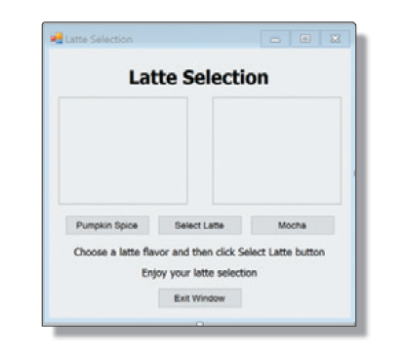
Sample Program — Phase 2: Design the User Interface (3 of 3)
contain pictures of pumpkin spice and mocha lattes, four Button objects, and three Label objects.

Slide 70
Summary
Completed the steps to create the GUI mock-up for the Latte Selection program
Many of the required steps are somewhat repetitive; the same technique is used repeatedly to accomplish similar tasks
When you master these techniques and other principles of user interface design, you will be able to design user interfaces for a variety of programs

